Slide 1
Informatics 312
Enterprise Risk Management

Slide 2
If you are new to the class today…
Please check in with Michaela Tran to be sure you are assigned to a small group.
Please carefully review my slides from last Wednesday, in which I went over the structure of the class as well as each of the assignments. And review Monday’s slides as well.
Please read the syllabus and the schedule carefully.
This is an in-person class, and you are expected to be here unless you are ill.
Both Michaela and I have office hours by appointment, so please contact one of us if you have any questions at all. Welcome!

Slide 3
Risk Review Debates
Jan 22: Facebook & Cambridge Analytica
Jan 29: Solarwinds
Feb 5: Microsoft Recall AI (2024)
Feb 12: National Public Data Breach (2024)
Feb 19: Apple-FBI encryption
Feb 26: Breach of telecommunication providers by China (2024)
Mar 5: BP Deepwater Horizon Oil Spill
Group 5 – Critique/ Group 2: Defense
Group 3 – Critique/ Group 6: Defense
Group 7 – Critique/ Group 4: Defense
Group 2 – Critique/ Group 1: Defense
Group 6 – Critique/ Group 7: Defense
Group 1 – Critique/ Group 5: Defense
Group 4 – Critique/ Group 3: Defense

Slide 4
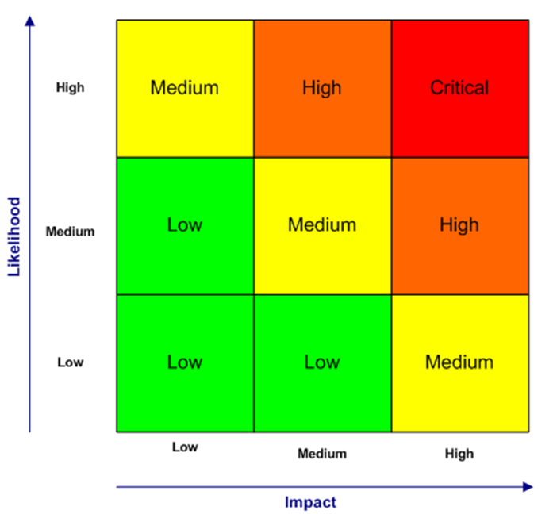
Current Events
Likelihood = what is its probability? How frequently will it occur?
Magnitude = of all our risks, where does this one sit? Impact = magnitude of loss

Slide 5
Risk Analysis

Slide 6
Risk Analysis
Risk analysis is a systematic process that involves identifying, assessing, and evaluating potential risks to understand their likelihood of occurrence and potential impact. Its objective is to develop strategies to manage or mitigate those risks effectively.
Notes:
Team, Wallstreetmojo. “Risk Analysis - What Is It, Benefits, Example, Methods.” WallStreetMojo, May 29, 2023. https://www.wallstreetmojo.com/risk-analysis/.

Slide 7
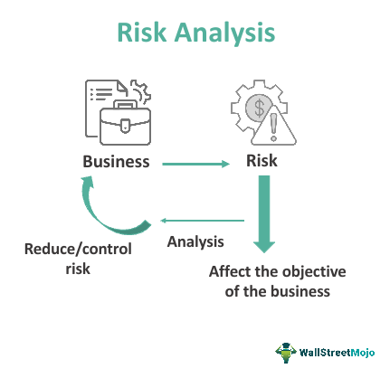
Risk Analysis
The risk analysis process typically includes identifying risks, assessing their probability and impact, analyzing their interdependencies, and developing risk mitigation strategies or contingency plans.
Notes:
Team, Wallstreetmojo. “Risk Analysis - What Is It, Benefits, Example, Methods.” WallStreetMojo, May 29, 2023. https://www.wallstreetmojo.com/risk-analysis/.

Slide 8
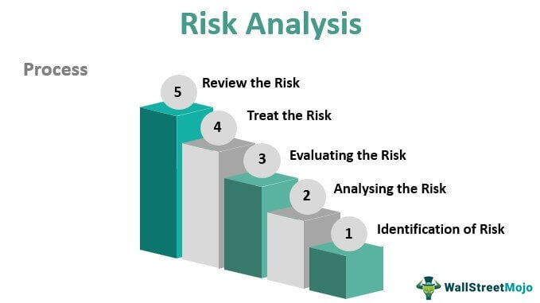
Risk Analysis
The risk analysis process typically includes identifying risks, assessing their probability and impact, analyzing their interdependencies, and developing risk mitigation strategies or contingency plans.
Notes:
Team, Wallstreetmojo. “Risk Analysis - What Is It, Benefits, Example, Methods.” WallStreetMojo, May 29, 2023. https://www.wallstreetmojo.com/risk-analysis/.

Slide 9
Risk Analysis - Approaches
Quantitative
the effect of the potential project risk that can be there on the target of the project is evaluated numerically.
Qualitative
the probability and impact of the potential project risk that can be there on the target of the project is evaluated against a predefined scale.
Notes:
Team, Wallstreetmojo. “Risk Analysis - What Is It, Benefits, Example, Methods.” WallStreetMojo, May 29, 2023. https://www.wallstreetmojo.com/risk-analysis/.

Slide 10
Risk Analysis – Key Factors
Likelihood (probability) of risk occurring in next year?
Significance (magnitude) of risk in terms of cost?
Rank the risks to get a score and a ranking
What are the interdependencies?
Business units may suffer the indirect consequences of a failure elsewhere in the enterprise, thus risks must be considered from this perspective as well, particularly when they fall into the technology dependencies area.

Slide 11
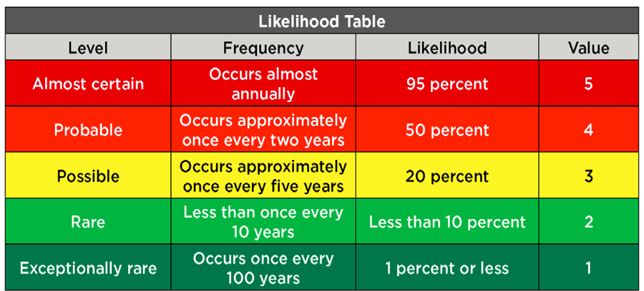
Risk Analysis – Likelihood

Slide 12
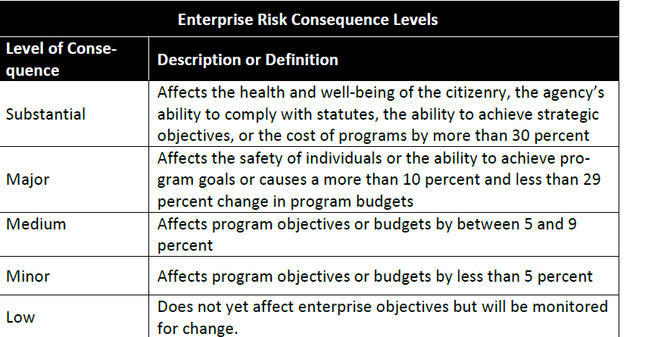
Risk Analysis – Significance/Severity

Slide 13
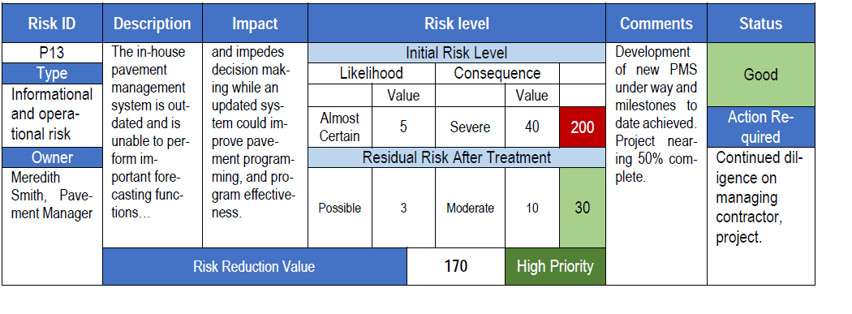
Risk Analysis – Register

Slide 14
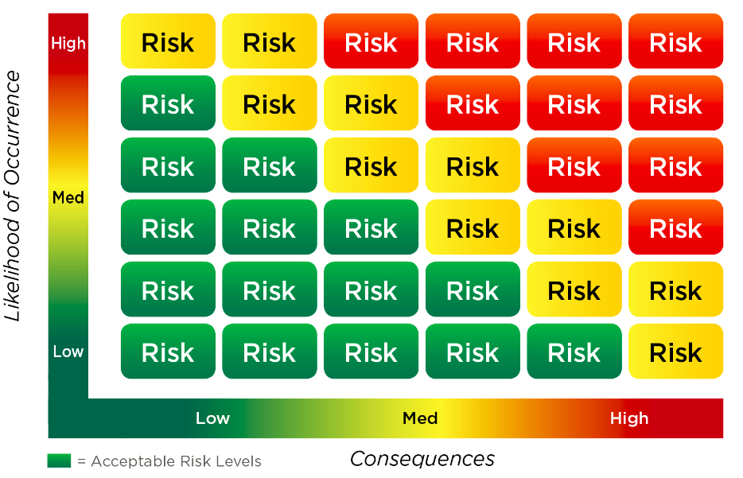
Risk Analysis – Map

Slide 15
Risk Analysis – Techniques
Delphi Method
Designate ERM “oracles” then pose questions and gather data
Problem --- anonymous internet surveys don’t gather same level of granularity as brainstorming or face to face interviews
Monte Carlo Simulation
A favorite of market and credit risk professionals
Build models describing the risk(s) and do computer simulation
Problem – risks rarely follow predictable models (“black swans”)
Decision Tree Analysis
Graph out multiple risk combinations in an “if/then” sequence
Joint probability rules and decision tree analysis can show underestimated impacts.

Slide 16
Risk Analysis – Benefits
Risk analysis methods helps to make very calculated and accurate decisions while performing a project as, without proper research, management of the project would not be considered to give positive results.
It helps in avoiding the potential losses that could occur in the future. Some risks which can be calculated and avoided and should be analysed for so that the business is able to perform the maximum using its existing resources.
It helps to determine the level of impact that a risk can have in an organization. This is very important because it helps in devising plans and strategies that will control or minimize the potential risk.
Notes:
Team, Wallstreetmojo. “Risk Analysis - What Is It, Benefits, Example, Methods.” WallStreetMojo, May 29, 2023. https://www.wallstreetmojo.com/risk-analysis/.

Slide 17
Risk Analysis – Limitations
It is measured based on probability, so it cannot give the exact measurement of the risk exposure.
Risk analysis is based on specific data, and if there is any manipulation in the data or the data is wrong, it will not give the correct results.
It requires the time and expertise of the person conducting the analysis. In case the person is not aware of all the techniques and methods necessary, then the desired purpose cannot be solved. Also, there is no standard method for its calculation, so it depends on the personal approach.
Notes:
Team, Wallstreetmojo. “Risk Analysis - What Is It, Benefits, Example, Methods.” WallStreetMojo, May 29, 2023. https://www.wallstreetmojo.com/risk-analysis/.

Slide 18
ERM Frameworks

Slide 19

General ERM Frameworks
COSO ERM Framework: The Committee of Sponsoring Organizations of the Treadway Commission’s (COSO) ERM Framework is one of the most widely recognized and applied risk management frameworks in the world. It was originally developed in 2004 and revised in 2017 to strengthen the emphasis on the integration of ERM with strategy and performance.
ISO 31000:2018: The International Organization for Standardization’s Risk Management Guidelines, ISO 31000:2018, is another widely used framework. It provides principles, a framework, and a process for managing risk that can be used by any organization regardless of its size, activity, or sector.
COBIT 5: short for Control Objectives for Information and Related Technologies, is a globally recognized framework developed by ISACA (Information Systems Audit and Control Association) for IT governance and management.
Notes:
Microsoft Copilot: Your everyday AI companion. “Microsoft Copilot: Your Everyday AI Companion.” Accessed April 2, 2024.

Slide 20
Purpose Specific Frameworks
OCTAVE Allegro
“The Operationally Critical Threat, Asset, and Vulnerability Evaluation (OCTAVE) methodology originates from Carnegie Mellon University in the USA. Older versions are still in use but the most recent version, OCTAVE Allegro, is more streamlined and is actively supported. It is primarily intended as a qualitative assessment, although may be used for simple quantitative analysis.” (NCSC)
Small group of participants from the operational and IT areas of the business, not requiring extensive expertise
Notes:
“The Optimal Risk Management Framework Identifying the Requirements and Selecting the Framework” 1 (n.d.).

Slide 21
Purpose Specific Frameworks
European Union Agency for Network and Information Security (ENISA)
The main motivation behind the framework is addressing the uncertainty of the accumulation risk of cyber incidents. (WP2017 O-3-3-2 1 Recommendations on Cyber Insurance)
Notes:
“The Optimal Risk Management Framework Identifying the Requirements and Selecting the Framework” 1 (n.d.).

Slide 22
Purpose Specific Frameworks
Communications Electronics Security Group (CESG) Information Assurance Standard 1 & 2
Purposes of issuing advice to UK government, public sector organizations and/or related organizations
Predominantly by central government departments, the wider public sector and its suppliers
Notes:
“The Optimal Risk Management Framework Identifying the Requirements and Selecting the Framework” 1 (n.d.).

Slide 23
Selecting the Right Framework
Is the framework or methodology selected by the firm understood by all?
Do these frameworks use quantitative factors or qualitative factors to evaluate risk?
What are several of the gaps in the frameworks that give one pause?
Notes:
“The Optimal Risk Management Framework Identifying the Requirements and Selecting the Framework” 1 (n.d.).

Slide 24
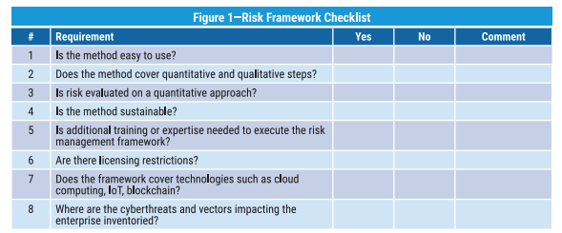
Selecting the Right Framework
Notes:
“The Optimal Risk Management Framework Identifying the Requirements and Selecting the Framework” 1 (n.d.).

Slide 25
ERM Frameworks Takeaways
There are a select few general industry standard ERM Frameworks
There are numerous purpose-built ERM Frameworks that are context-specific
Selecting the appropriate framework is context specific takes careful consideration

Slide 26
Regulations & Compliance

Slide 27
Regulations and Standards
Regulation | Description | Triggers | Requirements
HIPAA | Requires that protected health Information (PHI) be maintained in a secure and confidential manner | Billing Self-Insured Companies Business Associate Agreements | Encryption of PHI Standards for Deidentification Breach Notification Policy and Standards for Protection of Data
GLBA | Requires that Customers Personally Identifiable Information be secured regardless of where it lives. Also allowed for Investment and Savings banking to be offered at one institution. | Chartered as a financial institution under the guidance of the OCC, SEC | Protection of PII Vendor Security Breach Notification Required Information Security Function
SOX | Sarbanes – Oxley act required controls be maintained around financial reporting data. Those controls must be certified by independent 3rd party | Publically traded companies | Integrity of Accounting Data Self –Assessment Program Attestation of Controls
PCI | Payment Card Industry Standard requires the protection of cardholder account information | Companies Processing Payment card Information Requirements Based on Annual Transaction Volumes | Encryption or Obfuscation of Account Numbers Annual Assessment Program Attestation of Controls
FISMA | Federal Information Security Management Act Requires Institutions Gathering or Processing Information on the Governments behalf Handle that data according to risk based standards | Contractual Requirements Stipulation of Certain Grants or Information Sharing Agreements | Encryption of Sensitive Information Risk Assessment Program Identification and Notification of Breach
State Breach Laws | Many States Require that Individuals be Notified in the Event of the Breach of Their Personally Identifiable Information (PII) | Public or Private Sector Entities Storing or Processing PII | Encryption of PII Breach Notification

Slide 28
Sarbanes Oxley Act (SOX)
“The rules and enforcement policies outlined by the SOX Act amend or supplement existing legislation dealing with security regulations. The two key provisions of the Sarbanes-Oxley Act are Section 302 and Section 404.
Section 302 is a mandate that requires senior management to certify the accuracy of the reported financial statement. Section 404 is a requirement that management and auditors establish internal controls and reporting methods on the adequacy of those controls. Section 404 has very costly implications for publicly traded companies as it is expensive to establish and maintain the required internal controls.
In addition to the financial side of a business, such as the audits, accuracy and controls, the SOX Act also outlines requirements for information technology (IT) departments regarding electronic records. The SOX Act does not set forth a set of business practices in this regard but instead defines which company records need to be stored on file and for how long. It does not specify how a business should store its records, only that the IT department is responsible for storing them, according to standards outlined in the SOX Act.
Section 802 of the Act contains the three rules that affect record keeping. The first deals with destruction and falsification of records. The second strictly defines the retention period for storing records. The third rule outlines the specific types of business records that need to be stored, which includes electronic communications.”
Read more: Sarbanes-Oxley Act Of 2002 (SOX) https://www.investopedia.com/terms/s/sarbanesoxleyact.asp#ixzz5BdKemQht Follow us: Investopedia on Facebook

Slide 29
What are SOX’s major impacts?
PCAOB was established under the SEC to set standards for accounting and reporting and to oversee accounting firms. (First big changes since 1930s).
Section 201: Firm cannot outsource internal audit.
Section 301: Audit committee members = independent.
Section 302: CEO and CFO must certify their reports.
Section 404: Annual assessment and report of controls.
Called 10k annual reports and include internal controls assessment by both internal and external auditors.
Compliance reviews are serious and complex.
COSO and COBIT frameworks in place make them easier.
Section 409: Real time disclosure of significant problem.

Slide 30
SOX and Codes of Ethics
Required of key executives like CEO and CFO by SOx.
Should probably also require signoff from directors and other members of executive committee.
Includes “ethical handling of actual or apparent conflicts of interest between personal and professional relationships” as well as “full, fair, accurate, timely, and understandable disclosure,” and “compliance with applicable governmental rules and regulations”
SOx is primarily concerned with financial reporting; however enterprise level risks must be taken into account on the 10k report.

Slide 31
Compliance Issues
Compliance can change based on industry or location
Rules or regulations to comply with can come from
Government agency
Standards group (ASIS, COSO, Basel, etc.)
Internal corporate policies
A good compliance program identifies all exiting and pending rules or regulations and makes good citizens out of employees
SOX and Dodd-Frank financial reform are two of highest impact compliance programs for businesses

Slide 32
Essential compliance ingredients
Executive commitment
Compliance policy
Operational procedures including training and rewards
Active monitoring of environment with course corrections where necessary
Compliance risk assessment includes
Identify the risk and exposures
Measure the identified risks
Prioritize the risks based on likelihood and frequency
Develop a risk assessment matrix (high, medium, low)
Review the matrix
Communicate the matrix package to management

Slide 33
Why Frameworks?

Slide 34
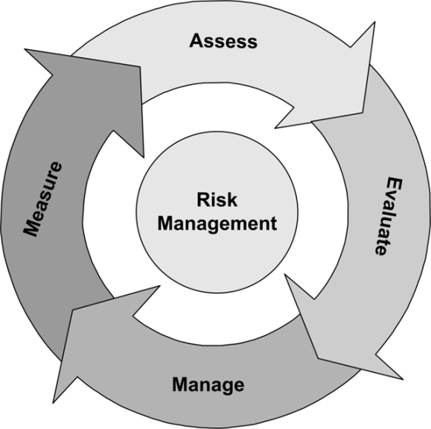
ISO 31000 Standard
Risk management is the identification, assessment and prioritization of risks (ISO 31000);
Enterprise risk management can include the coordinated and economical application of resources to
Minimize
Monitor
Control
…the probability and/or impact of
unfortunate events (loss) or to
maximize the realization of
opportunities (profit).

Slide 35
Example: PwC Representation (ISO Standard)
Likelihood | Definition | Description
1 | Unlikely | Unlikely to occur within the timeframe described in the objective
2 | Likely | Likely to occur in this timeframe
3 | Certain/Imminent | Expected to occur in this timeframe
Impact | Definition | Description
1 | Negligible | Will not impede achievement, minimal reputational damage.
2 | Moderate | Will cause delay on some
3 | Critical | Objective will not be met

Slide 36
Questions we have to ask on risks
Have Risks Been Ranked and Treated by Criticality?
Likelihood or Frequency – how often?
Consequence or Magnitude – how severe?
Uncertainty – See next slide with Lam’s animal kingdom.
Are There Internal Controls and Risk Thresholds?
Aim to prevent the event and reduce likelihood (safety issues, emerging threats)
Aim to detect the event in case it happens to reduce consequence (monitoring, risk registers)
Aim to react and respond, to react and reduce the consequences (internal and external events)

Slide 37
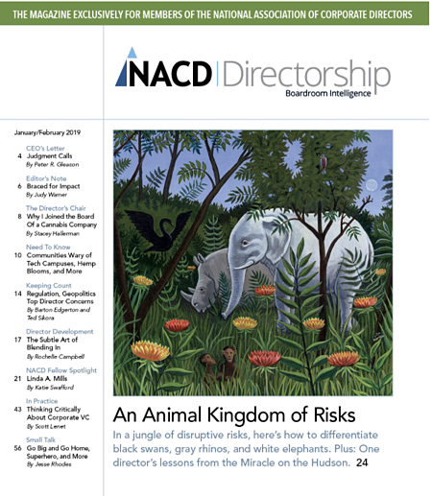
James Lam’s Kingdom of Disruptive Risks
Black Swans – unknown unknowns (Outliers that few see coming). Ex: 9/11, 2008 financial crisis.
Gray Rhinos – known unknowns (Probable high impact trends seen coming but don’t know how to respond). Ex: AI, Cyber, Climate Change.
White Elephants – known knowns (Extant, no-win, highly emotional situations, tricky issues like “#MeToo, Elon Musk, Big Pharma that if we do nothing have worst outcomes.)

Slide 38
Lam: Cognitive bias can lead to errors
“Availability and hindsight bias: underestimating risks we have not experienced and overestimating risks that we have. A key barrier to seeing atypical risks until it is too late.
Optimism bias: overestimating the likelihood of positive outcome and underestimating negative outcome.
Confirmation bias: preference for information that one agrees with. Prevents responding to early signals.
Groupthink or herding: when consensus is sought at the expense of an objective assessment of alternate viewpoints.
Myopia or short-termism: Tendency to have narrow view and focus on short term results, rejecting long term investments.
Status quo: Preserve the current state.

Slide 39
Risk Assessment

Slide 40
Risk identification
Tough to do properly
Must be done at business unit level, not only at the top
Examples abound of companies brought down by activities in one line of business that were not surfaced through risk reporting or were not appropriately quantified
Even once risk is identified, there is often a scramble to minimize the level of risk it poses
No desire to spend the funds to close a gap where threat level is unclear
No desire to become the focus of additional assessments by audit or regulators
Possibility of financial loss from gap is unknown/unlikely (low frequency, high impact events like earthquakes, power grid breaches, cyber intrusions)

Slide 41
How to proceed with risk ID?
Get out the organization charts
Lines of business and reporting structure
Facilities with their own org charts
Central corporate administrative team
Executive team
Risks should be identified in each area
Interviews as well as questionnaires
View of risk exposure may be different from executive suite than it is from the business line (take business line seriously, then compare to other risks that surface across company)
Identify the risk outliers and anomalies
Always ask – “are there risks in your area that may be unknown?”
Always ask – “what is our greatest risk in this area?”

Slide 42
Organize risks into types
Strategic
Operational
External
Industry
Economic
Competitor
Legal/Regulatory Change
Customer (needs & wants)
Internal
Reputation
Strategic Focus
Parent Company Support
Patent/Trademark Protection
Process
Supply Chain
Customer Satisfaction
Cycle Time, Process Execution
Compliance
Environmental, Regulatory
Policy & procedures
Litigation
People
Human Resources
Employee Turnover
Performance Incentive
Training Failure

Slide 43
Additional types of risk
Finance
Information & Technology
Treasury
Interest rate
Foreign exchange
Capital availability
Credit
Capacity
Collateral
Concentration
Default, Settlement
Trading
Commodity Price
Duration Risk
Measurement
Financial
Accounting Standards
Budgeting
Financial Reporting
Taxation
Regulatory Reporting
Operational
Pricing
Performance Measurement
Employee Safety
Technological
Information Access
Business Continuity
Virus/Systems Access
Availability
Infrastructure

Slide 44
How to assemble a list of key risks
From brainstorming sessions where risks identified are ranked by voting, the ERM team can ask
“Is the risk common across the enterprise or… unique to just one business group?
Will the enterprise face the risk because of internal events within the company or through external events?
Are the risks related? That is, will one risk cause another to occur?”
Find the “core risks” or “major risks” such as
Customer satisfaction drops
New competitor
Control weakness identified during financial close
Risk that auditors find one or more significant control weaknesses to report to board of directors

Slide 45
Multiple approaches
Identify Top 10 risks and classify them as “high,” “medium” or “low”
Buy business insurance where possible to handle highest risks
Use more qualitative tools to identify and assess the risk
Understand risk management best practices
Isolate the largest gaps in programs or processes
Work from a roadmap to close the gaps in order of priority
Risk assessment steps no matter what approach
Risk identification
Quantitative or qualitative assessment of risks you document
Risk prioritization and response planning
Risk monitoring
Implement this process at all levels, no matter how large or small the business

Slide 46
Key risk assessments
Likelihood (probability) of risk occurring in next year?
Significance (magnitude) of risk in terms of cost?
Rank the risks to get a score and a ranking
What are the interdependencies?
Business units may suffer the indirect consequences of a failure elsewhere in the enterprise, thus risks must be considered from this perspective as well, particularly when they fall into the technology dependencies area.
Quantitative risk analysis: “go through each of key risks and estimate the costs of incurring the designated risk.”

Slide 47
Other risk assessment techniques
Delphi Method
Designate ERM “oracles” then pose questions and gather data
Problem --- anonymous internet surveys don’t gather same level of granularity as brainstorming or face to face interviews
Monte Carlo Simulation
A favorite of market and credit risk professionals
Build models describing the risk(s) and do computer simulation
Problem – risks rarely follow predictable models (“black swans”)
Decision Tree Analysis
Graph out multiple risk combinations in an “if/then” sequence
Joint probability rules and decision tree analysis can show underestimated impacts.

Slide 48
Sources of Risk
The “convenience” of smart devices has changed the risk exposure levels for companies
People – human error, failure to follow procedures
Downloading corporate data and storing it in unmanaged locations
Process – no procedure or bad procedures
Sharing complex information outside the office, in the field
Systems – technology platforms are outdated, unstable
Data is not encrypted, information security is not mature
External – natural disasters, cyber-threats/terrorism
Using social media to communicate during disasters
Employees vulnerable to “click here” phishing scams, which allow hackers access to your network

Slide 49
It’s hard for a business to succeed without effective risk assessment
Which risks are opportunities?
Which could be “potential pitfalls?”
Foundational COSO Principles
“The assessment should begin and end with specific business objectives [that provide basis to measure impact and probability] that are anchored in key value drivers.”
Governance must be established so as to look across.
“Capturing leading indicators enhances the ability to anticipate possible risks and opportunities before they materialize.”

Slide 50
Different environments for events that increase risk levels
External environment
Economic trends (What would be an example here?)
Regulatory landscape (AML, Basel II, SOX, for example require RAs)
Competition (What would be an example here?)
Internal environment
People
Process
Infrastructure
New COSO definition = “the possibility that an event will occur and adversely affect the achievement of objectives.”

Slide 51
Risks can be “heat mapped” – it’s another tool not unlike a risk register
Risks can span many categories in the enterprise besides operational risks, especially if business strategy is changing:
Market
Credit
Product
Liquidity
Accounting
Legal
Reputational
Map risks to impact (severity) and likelihood (probability) both on an risk that is inherent and risk that is residual.

Slide 52
Inherent vs. Residual Risk (COSO)
Inherent – risk that exists without any attempt to reduce or mitigate it.
Residual – what remains after the risk has been treated.
Velocity of risk – the time it takes for a risk event to manifest itself. The time between onset of an event and when the enterprise feels it. Estimating this properly helps build the right risk response.

Slide 53
Frequency v Impact Grid
Likelihood = what is its probability? How frequently will it occur?
Magnitude = of all our risks, where does this one sit? Impact = magnitude of loss

Slide 54

Categorizing Enterprise Risk
Financial | Legal and Regulatory
Geopolitical | Industry/Marketplace
Strategic | Catastrophic
Human | Operational
Environmental | Third Party Risk (contracting)
Information Technology | Reputational
A black swan event
Is out of the realm of reasonable expectations
Has dire consequences
Afterward, we can easily explain.
(Taleb, The Black Swan)

Slide 55
Examples of Black Swan events
The rise of the Nazis in Germany of the 1930's
The atomic bombings of Hiroshima and Nagasaki
The invention of the internet
September 11, 2001
The Arab Spring
The Iranian revolution of 1979
Boston bombings 2013
Boeing 737MAX groundings
Coronavirus 2020

Slide 56
ISO Risk Management Process
Similar to 1930s “plan, do, act, check” processes (Shewhart)
Similar also to other process-improvement processes like
Six Sigma
Lean
Steps to establish a program
Appoint a risk manager to lead development of tools, including workshop and scale tools
Provide staff training
Develop a risk manual or guide
Create risk tables and registers to document consequences/likelihood
Create a risk website or some other reporting mechanism
Keep tools simple and management practical
Integrate risk management into agency processes

Slide 57
The small group question:
Security Risk
Appoint a scribe/speaker. (Can rotate by week if you wish)
Capture names of all members of group present on your report.
Please add your responses directly to the discussion board.
You have 20 minutes to construct report in PowerPoint/ Google Slides.
Because there are 7 groups, please choose to report only one of your bullet points, to leave room for other groups’ reports.

Slide 58
The Question
In November 2020, the Trump administration declared downloads of the Tik Tok and WeChat apps to be threats to national security and banned them both as of November 20, 2020.
The Biden administration has since reversed the order and is conducting its own "evidence-based" analysis of the potential security risks of using the apps.
What are the risks that the applications pose? Be specific.
Is there a way to mitigate the risks that each app poses?
Groups 1-4 Take Tik Tok;
Groups 5-7 Take WeChat.

